Slide 1

MRA-TaxNet APPLICATION
INTERFARCE PROTOTYPE
Chafukira Allan
achafukira@gmail.com | +265 881 60 60 76

Slide 2
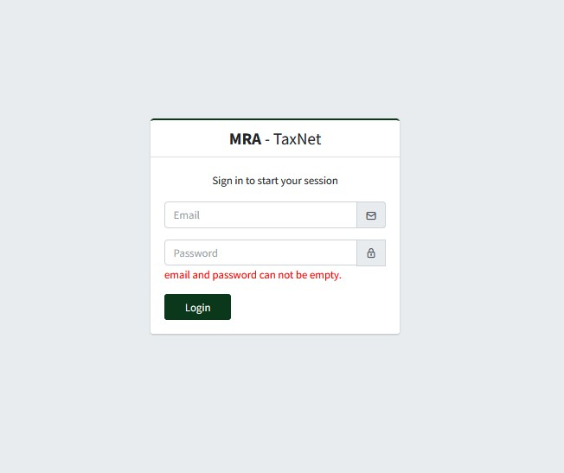
LOGIN SCREEN

Slide 3
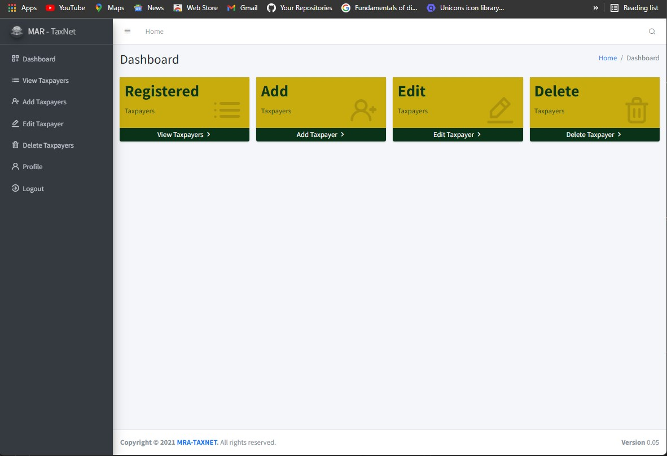
DASHBOARD SCREEN
Action Tabs
Side Menu
Footer

Slide 4
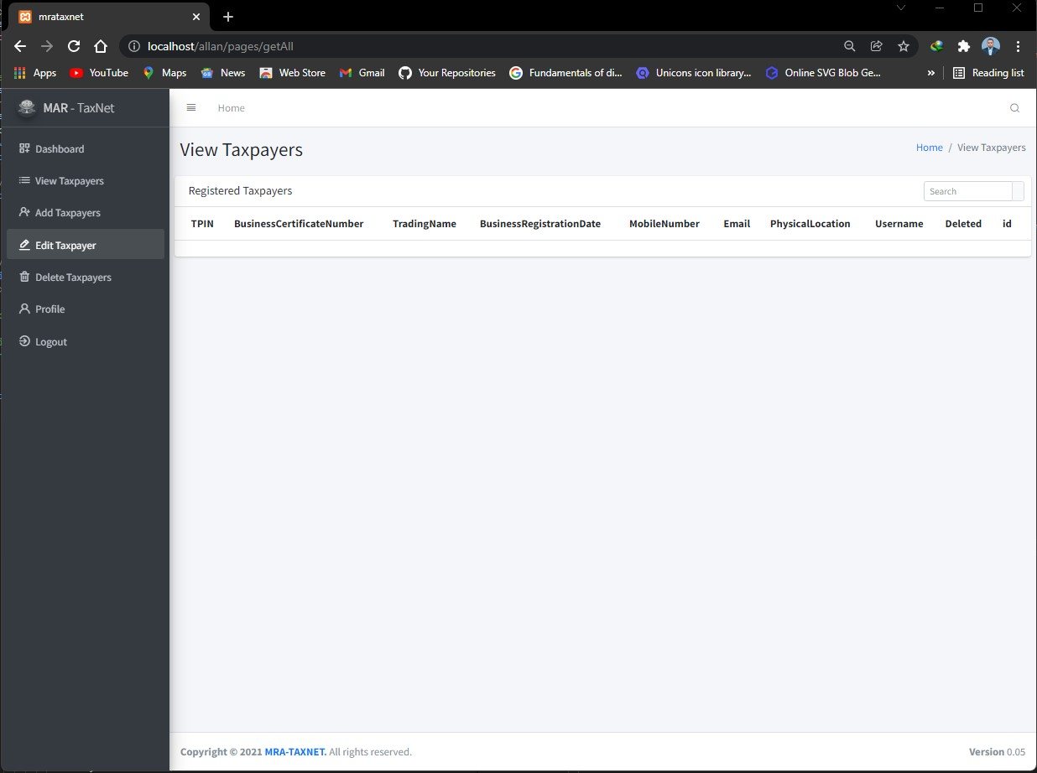
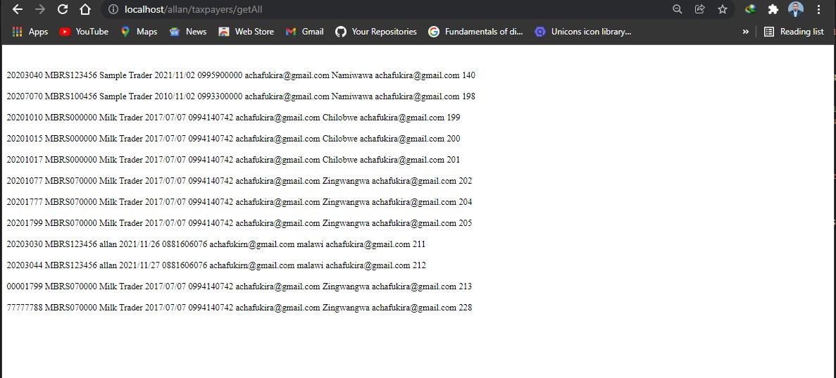
VIEW TAXPAYER SCREEN
Table Headers

Slide 5
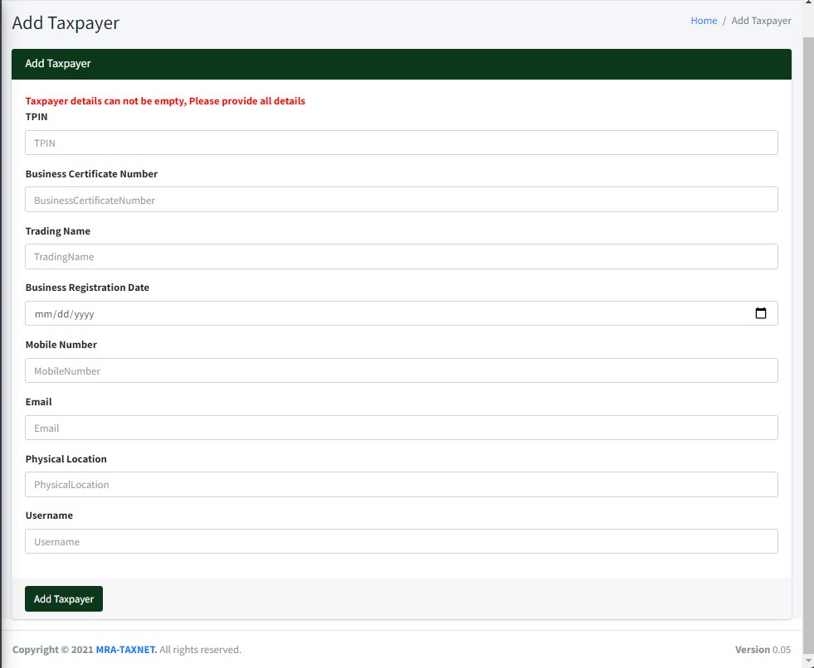
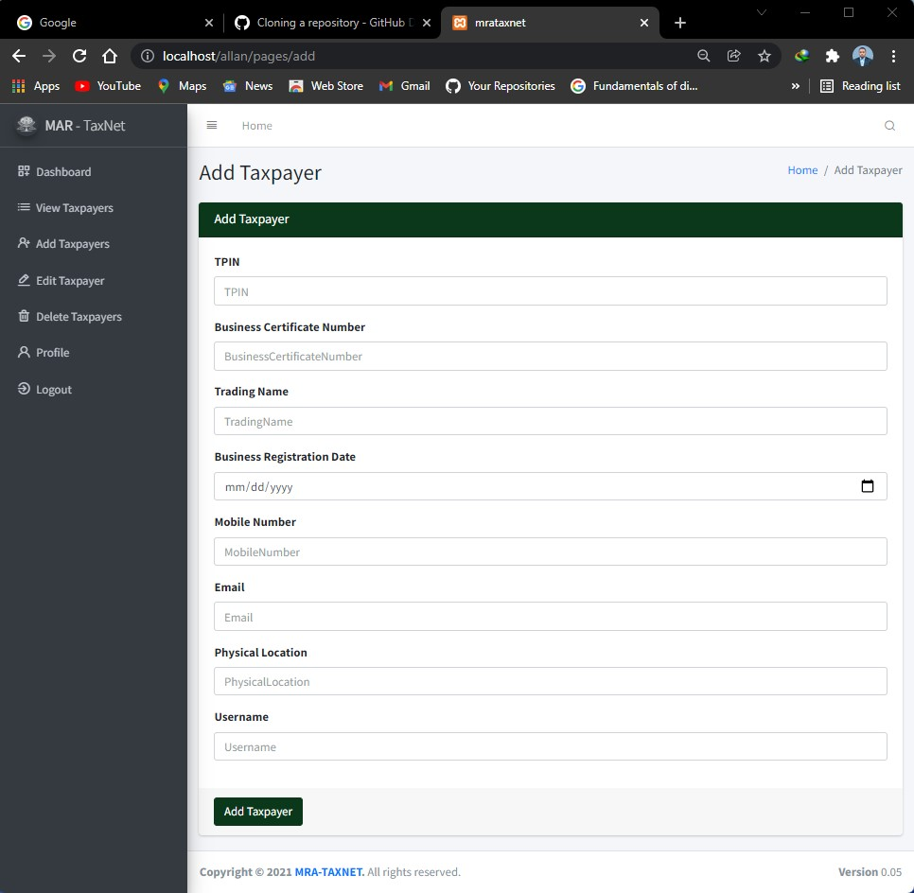
ADD TAXPAYER SCREEN/FORM

Slide 6
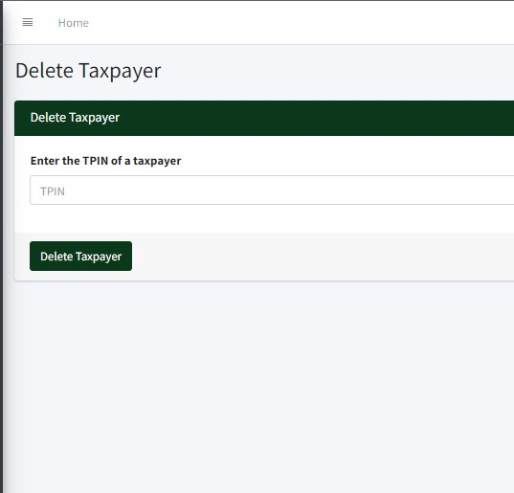
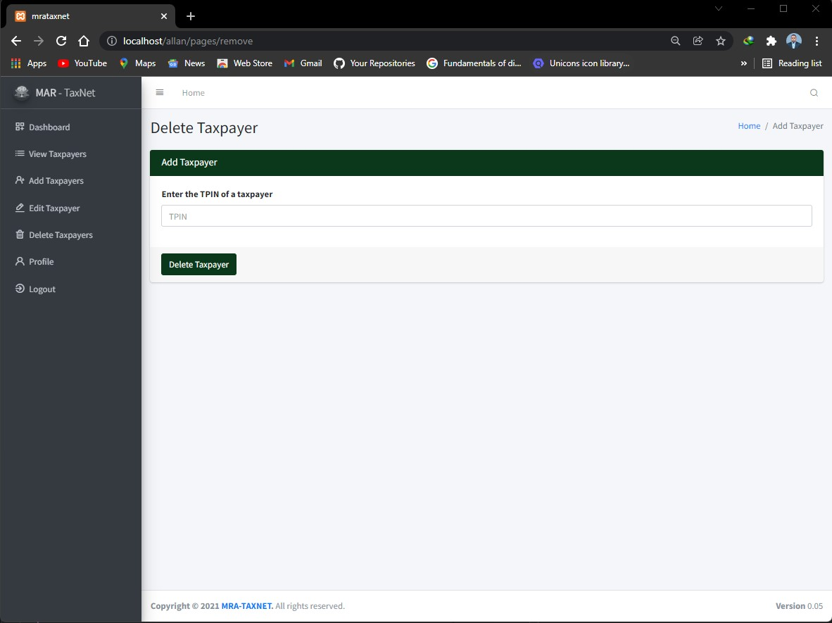
DELETE TAXPAYER SCREEN

Slide 7
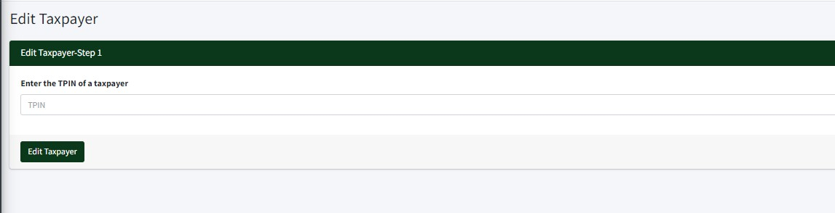
EDIT TAXPAYER SCREEN - 1

Slide 8
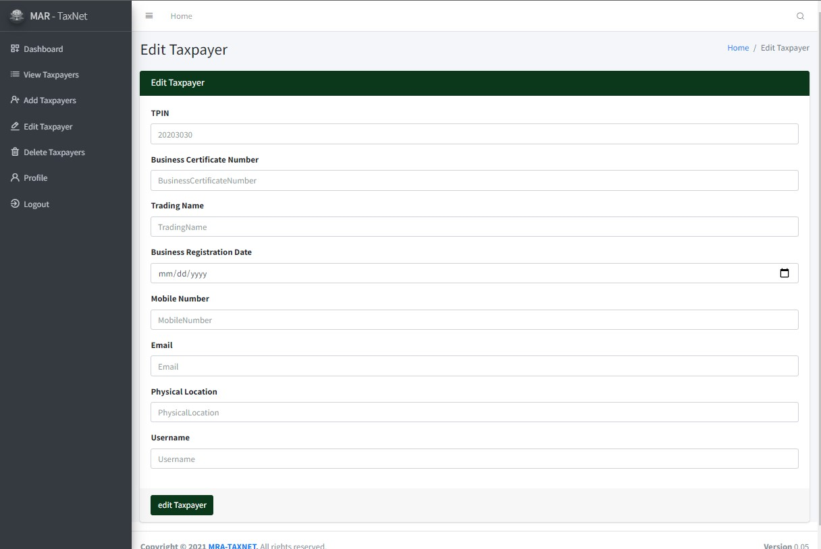
EDIT TAXPAYER SCREEN - 2

Slide 9
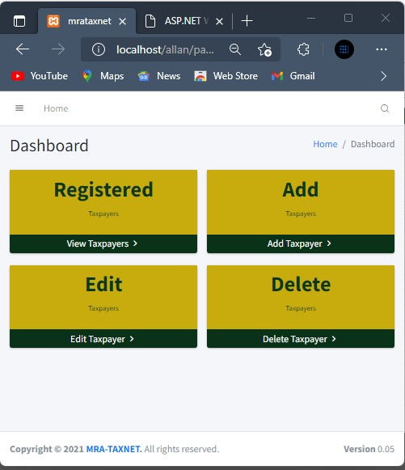
RESPONSIVE SCREEN

